Slide 1
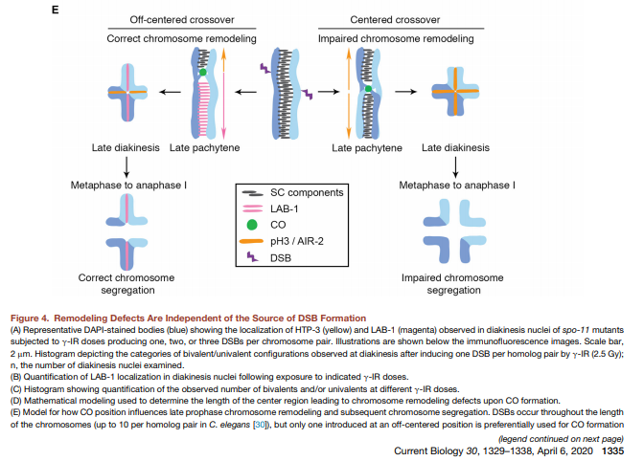
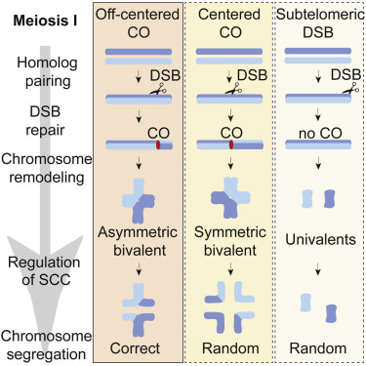
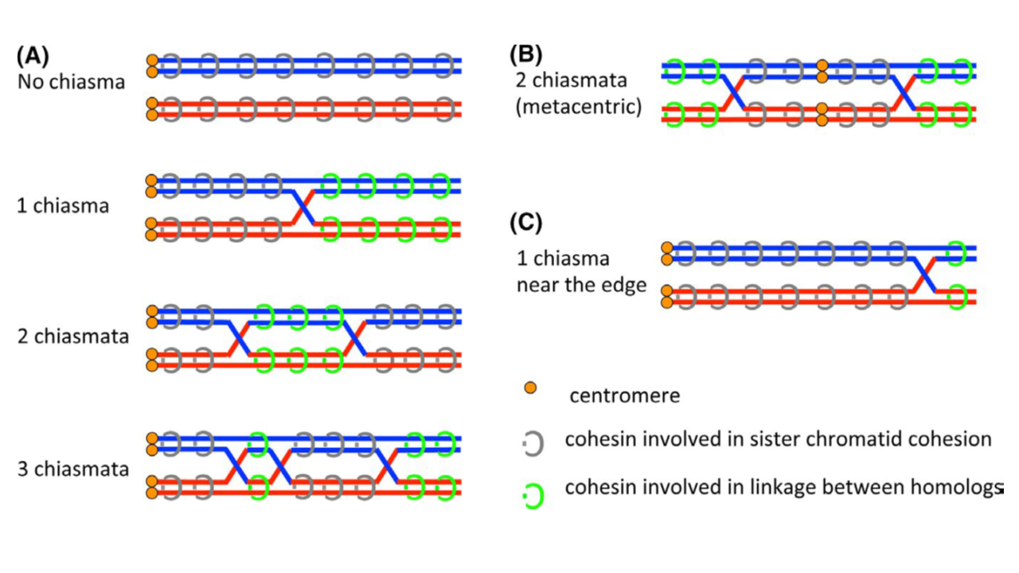
MI spindle selection based
Bivalent str
alterdorer
Lee
Notes:
Why is symmetrical crossover placement bad?
-resrouce limited?
-sub-optimal physiological signal

Slide 2
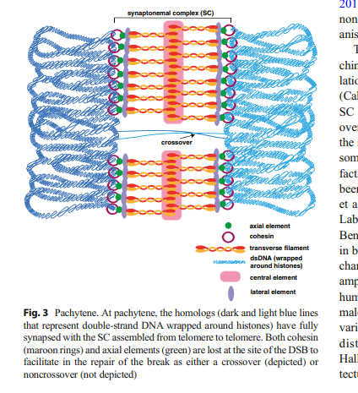
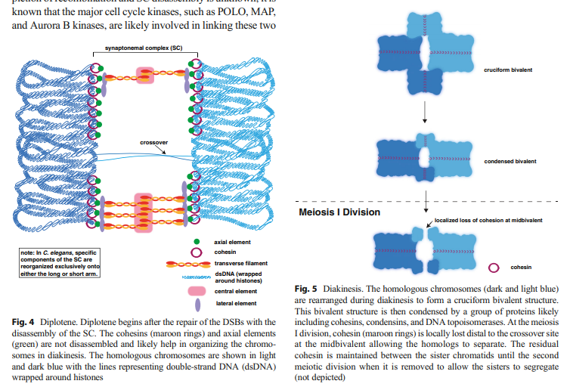
Cahoon, C. K., & Libuda, D. E. (2019). Leagues of their own: sexually dimorphic features of meiotic prophase I. Chromosoma, 1-16.

Slide 3
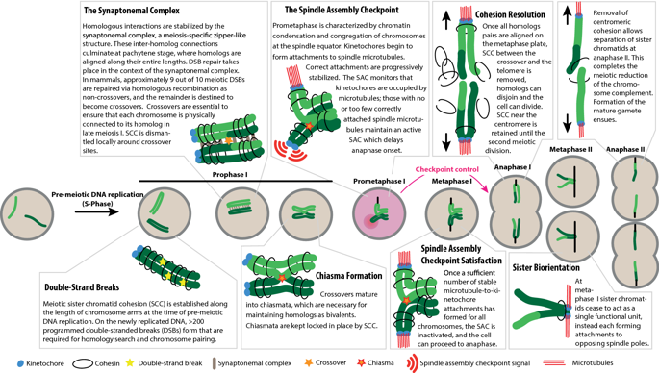
Lane, S., & Kauppi, L. (2019). Meiotic spindle assembly checkpoint and aneuploidy in males versus females. Cellular and molecular life sciences, 76(6), 1135-1150.

Slide 4
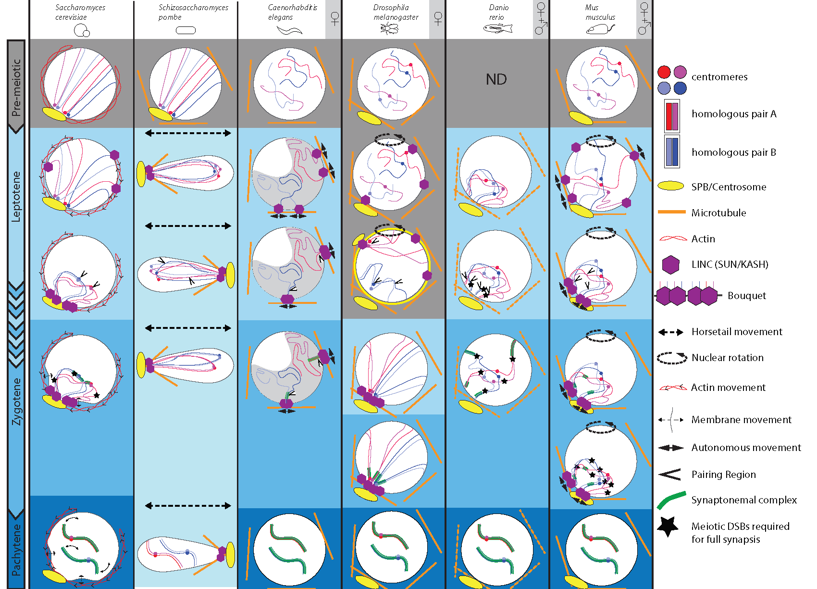
Homolog Pairing Selection
Rubin, T., Macaisne, N., & Huynh, J. R. (2020). Mixing and Matching Chromosomes during Female Meiosis. Cells, 9(3), 696.
Notes:
That one paper….

Slide 6
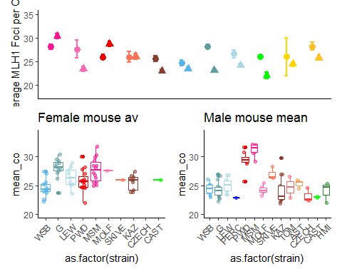
Main MLH1 figure
Notes:
Copy from code

Slide 7
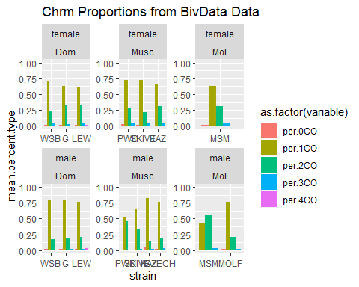
Chromosome Proportion differences

Slide 8
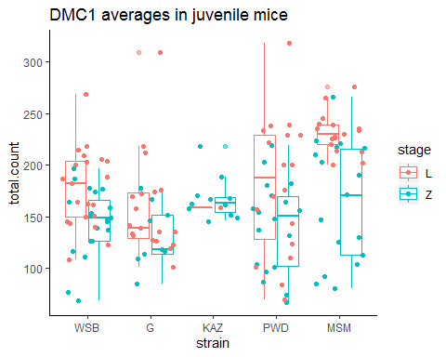
DMC1 results

Slide 9
Position (1CO)

Slide 10
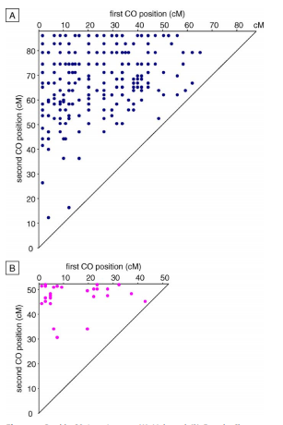
Male
First CO position
Double crossover Chrm4, Arabidopsis thaliana.
Diagonal line, 1:1 values, the shortest interfocal distance (IFD).
Near top corner, longest IFD
Enrichment of longest IFDs
Lack of small IFDs
Second CO position
Female
First CO position
Enrichment of longest IFDs
Drouaud, J., Mercier, R., Chelysheva, L., Bérard, A., Falque, M., Martin, O., ... & Mezard, C. (2007). Sex-specific crossover distributions and variations in interference level along Arabidopsis thaliana chromosome 4. PLoS genetics, 3(6).

Slide 11
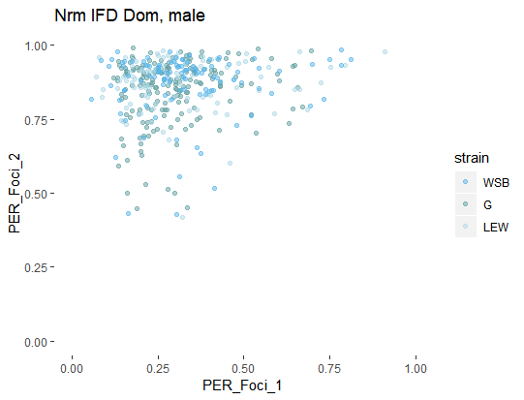
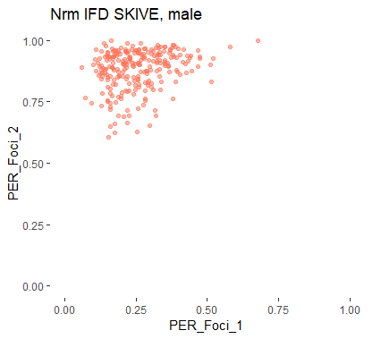
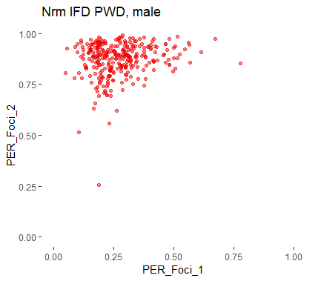
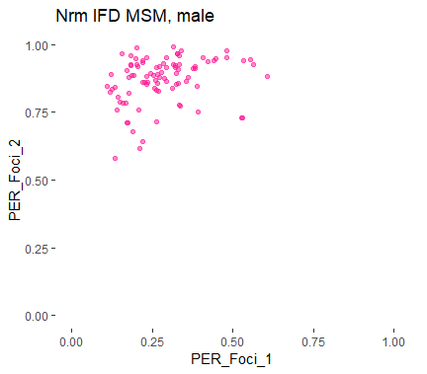
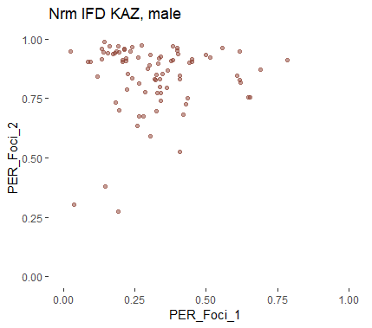
Rapid evolution of interference IFDs
‘normal’ IFD lengths
Significantly longer IFD

Slide 12
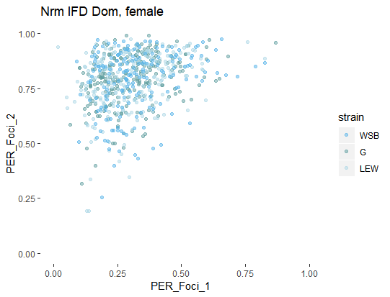
Sex difference in IFD distributions
Notes:
Interference strength examples
(based on Dourad et al (link)
Generic example plot;
Show the difference in IFD length via closeness to diagonal line. Put example
(could try 3 axis for the 3 COs)
Centromere – supression,
Male – female difference – telomere bias (the enriched points around the top of plot
PWD – DOM, differences not quite clear (in contrast to the boxplots)

Slide 13
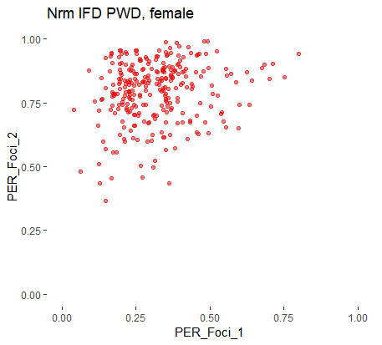
IFD figure
Longer IFD
Shorter IFDs
Notes:
Interference strength examples
(based on Dourad et al (link)
Generic example plot;
Show the difference in IFD length via closeness to diagonal line. Put example
(could try 3 axis for the 3 COs)
Centromere – supression,
Male – female difference – telomere bias (the enriched points around the top of plot
PWD – DOM, differences not quite clear (in contrast to the boxplots)

Slide 14
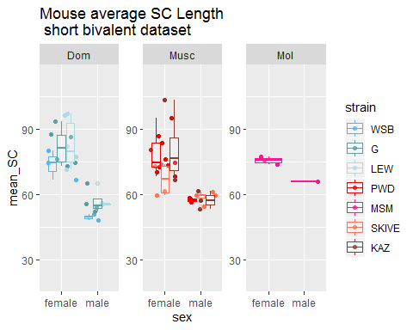
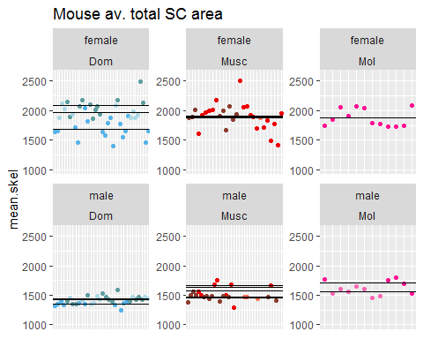
SC length (by chromosome class)

Slide 16
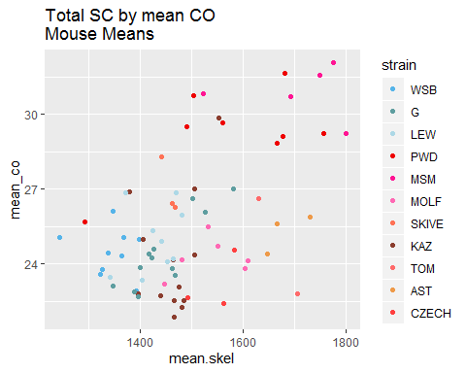
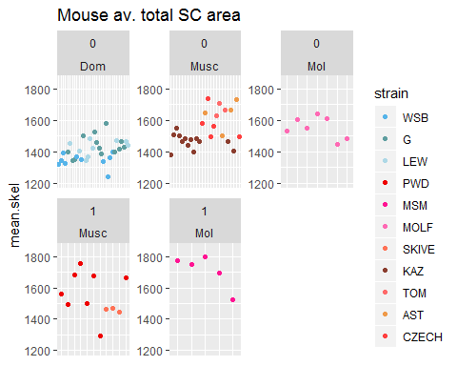
Q2 SC differences

